Slide 1


From Mental Health to…
THE Behavioral Health and Developmental Disability Act of 2020
By: Sansara A. Cannon Esq.

Slide 2
"Current Virgin Islands Law Does Not Deal With Developmental Disabilities and Scatters Mental Health and Some Behavioral Health Across the VI Code into Different Titles, Parts, and Chapters…”
“So nothing is in one place? Correct! - #HARDREAD”
new Behavioral Health and Developmental Disability Act – Expands and updates mental and behavioral health SERVICES and Puts every existing provision in the vi code relevant to mental or Behavioral health into
one place…one part…
Four chapters

Slide 3


Old Chapter(s)
Part I General Provisions (Chs. 1-13)
Part III Food and Drug (Chs. 25-34)
Part V Mental Health (Chs. 45-48)
Part VIII Mental Retardation Facilities and Community Health Centers Construction Act (Chs. 73-75)
Subtitle 3 Criminal Procedure (Pts. I-III)
Chapter 7. Maternal, Child Health, Physical Disability and Intellectual Disability Children's Services (§§ 151 — 153)
Chapter 31. Behavioral Health, Alcoholism and Drug Dependency (§§ 710 — 729)
Chapter 47. Virgin Islands Central Cancer Registry Program (§§ 1251 — 1259)
Chapter 48. Autoimmune Disease Registry (§§ 1261 — 1267)
Chapter 75. Fluoridation of Water (§§ 4201 — 4204)
Chapter 309. Conduct of the Trial; Verdict (§§ 3631 — 3638)
Chapter 29. Controlled Substances (Subchs. I — V)
Part V. Behavioral Health and Developmental Disability Act (Chs. 45 - 48)
Chapter 45. Behavioral Health, Mental Health Disorders, Developmental Disabilities, and Alcohol or Drug Dependency (Subchs. I – III)
Chapter 46. Mental Health (Subchs. I – X)
Chapter 47. Intellectual and Developmental Disabilities (§§1114 –1119)
Chapter 48. Behavioral Health for Children and Young Adults (§§ 1120 – 1123)
New Act

Slide 4
Sections Repealed
Chapter 30 Virgin Islands Commission on Alcoholism and Narcotics (§§ 701 — 704) Repealed
§701 is repealed
§702 is repealed
§703 is repealed
§704 is repealed
Chapter 31. Behavioral Health, Alcoholism and Drug Dependency (§§ 710 — 729); Partial Repeal
§716 is repealed
§717 is repealed
§726 is repealed
§746 is repealed
Chapter 45. Mental Health. Subchapters I - V (§§ 1101-1204) Repealed
§1101 is repealed
§1111-1114 are repealed
§1130-1143 are repealed
§1171-1177 are repealed
§1201-1202 are repealed
§1204 is repealed
Original Code Sections Incorporated
Part I. Chapter 7. Maternal, Child Health, Physical Disability and Intellectual Disability Children's Services (§§ 151 — 153)
Chapter 29. Subchapters IV. Civil Commitment and Rehabilitation of Narcotic Addicts (§§ 661 — 666) and Subchapter V. Civil Commitment of Persons Not Charged with Any Criminal Offense (§§ 681 — 696);
VIII. Mental Retardation Facilities and Community Health Centers Construction Act (Chs. 73 — 74)
Title 5, Subtitle 3 Criminal Procedure; Chapter 309 Conduct of Trial - Section 3637 Mental Illness of Defendant

Slide 5
WHAT IS NEW?
New Chapter 45 Behavioral Health, Mental Health Disorders, Developmental Disabilities, and Alcohol or Drug Dependency (Subchs. I – III)
  New Subchapter I. Community Behavioral Health Services (§§ 1000-1009)
  Additions to New Subchapter II. Divisions, Programs, Treatment, Patient Rights (§§1022-1028; §1030-1031; §1033-1036; and §1038
  New Subchapter III Behavioral Health, Mental Health, Developmental Disability, Alcohol or Substance Abuse Facility (§§ 1041-1044)
New Chapter 46 Mental Health (NEW Subchs. I – X)
  Subchapter I. Commitment, Examination, and Reports (§§ 1045 – 1053)
  Subchapter II. Mental Competency (§§ 1054 – 1059)
  Subchapter III. Not Guilty by Reason of Insanity (§§ 1060 - 1067)
  Subchapter IV. Hospitalization of an Imprisoned person (§§ 1068 - 1072)
  Subchapter V. Hospitalization of Person Due for Release (§§ 1073 – 1077)
  Subchapter VI. Hospitalization of a Person Due for Release but Suffering from Behavioral Health Challenges or Mental Health Disorders (§§ 1078 – 1083)
  Subchapter VII. Civil Commitment of a Sexually Dangerous Person (§§ 1084 – 1089)
  Subchapter X. Telepsychology or Telehealth (§§1112-1113)
New Chapter 47 Intellectual and Developmental Disabilities (NEW §§1114 –1119)
New Chapter 48. Behavioral Health for Children and Young Adults (§§ 1120 – 1124)
  New section 1124. Application of the Children’s Policy
As mentioned previously the new Behavioral Health and Developmental Disability Act reorganizes the VI Code and adds to it, what wasn’t included previously and is now present through this Act →
*provisions or sections not indicated as new are original sections from the current VI code that have been incorporated into the new Act but renumbered, retitled, and relocated

Slide 6
WHAT IS IMPORTANT?
Crisis Intervention
Behavioral Health Training
Protective Custody
Involuntary Treatment
Transfer,
Behavioral Health, Mental Health, Developmental Disability, Alcohol or Substance Abuse Treatment Facility
Hospitalization – Prisoners, Persons Due for Release, Sexually Dangerous Person
Telepsychology and Telehealth
Intellectual and Developmental Disabilities
Progressive Treatment Program
Behavioral Health Policies for Children and Young Adults
Mental Health & Behavioral Health:
Commitment
Examination
Competency
Insanity
Transportation,
Support
Maintenance and Care of Patients
Hearings
New Key Provisions
Incorporation of Original Provisions
Expansion of all provisions to cover and provide services in all these areas:
  Behavioral Health
  Mental Health
  Developmental Disability
  Alcoholism
  Drug Dependency and Substance Abuse

Slide 7

Table of Contents With New Provisions Highlighted
Attached for further review on each new section

Slide 8
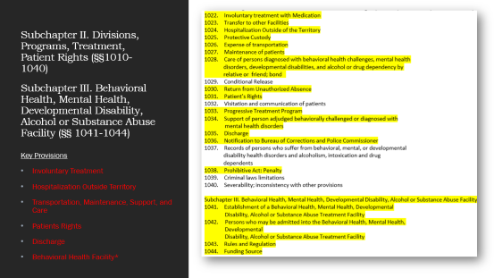
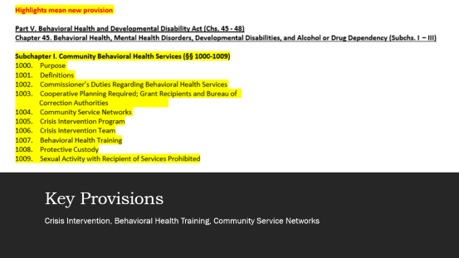

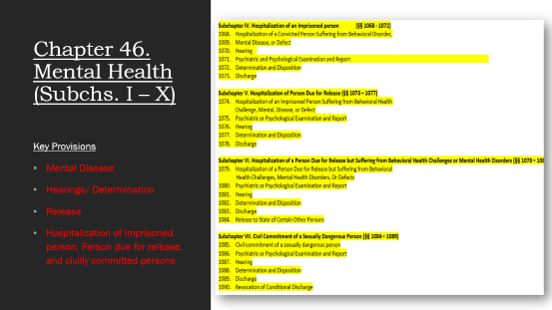
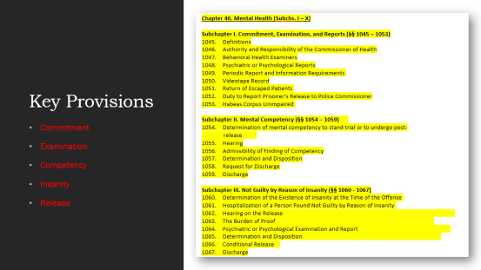
Table of Contents With New Provisions Highlighted

Slide 9
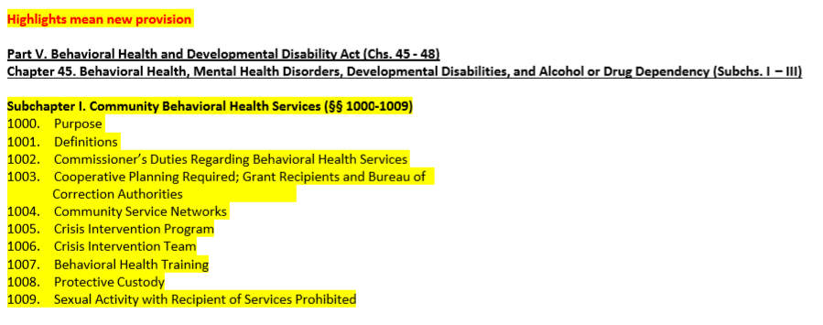
Key Provisions
Crisis Intervention, Behavioral Health Training, Community Service Networks

Slide 10
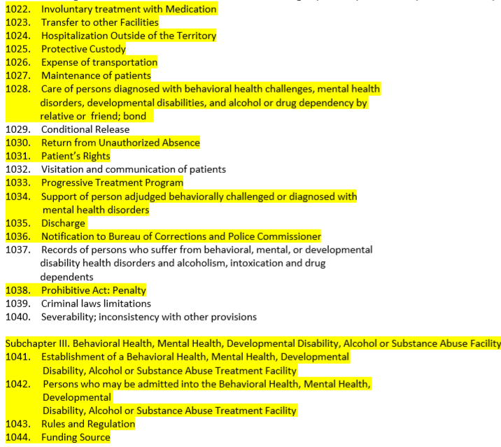
Subchapter II. Divisions, Programs, Treatment, Patient Rights (§§1010-1040)
Subchapter III. Behavioral Health, Mental Health, Developmental Disability, Alcohol or Substance Abuse Facility (§§ 1041-1044)
Key Provisions
Involuntary Treatment
Hospitalization Outside Territory
Transportation, Maintenance, Support, and Care
Patients Rights
Discharge
Behavioral Health Facility*

Slide 11
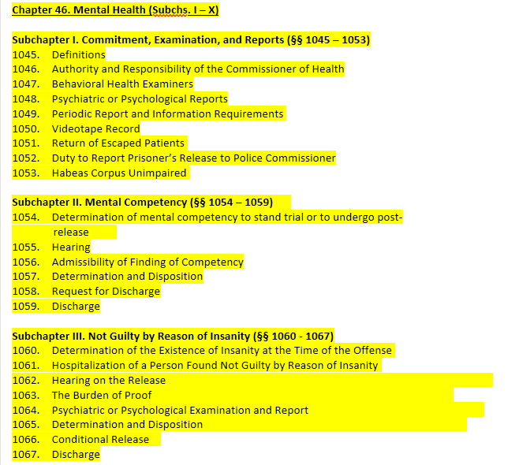
Key Provisions
Commitment
Examination
Competency
Insanity
Release

Slide 12
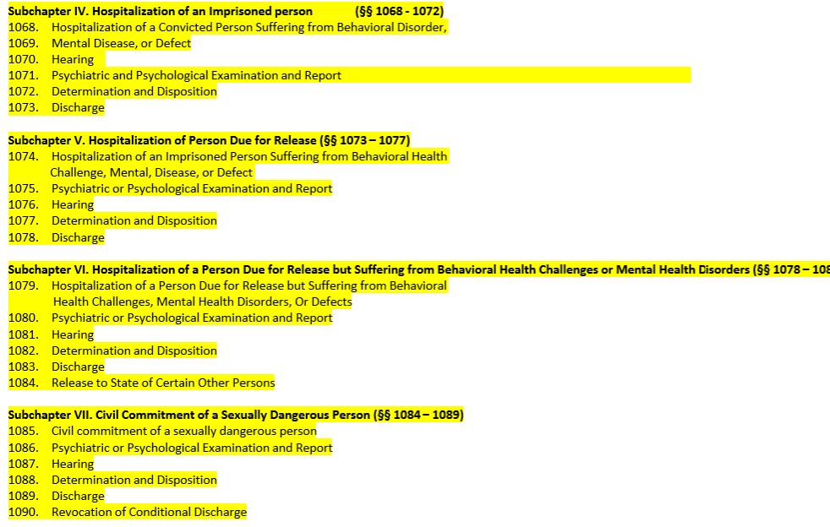
Chapter 46. Mental Health (Subchs. I – X)
Key Provisions
Mental Disease
Hearings/ Determination
Release
Hospitalization of Imprisoned person, Person due for release, and civilly committed persons

Slide 13
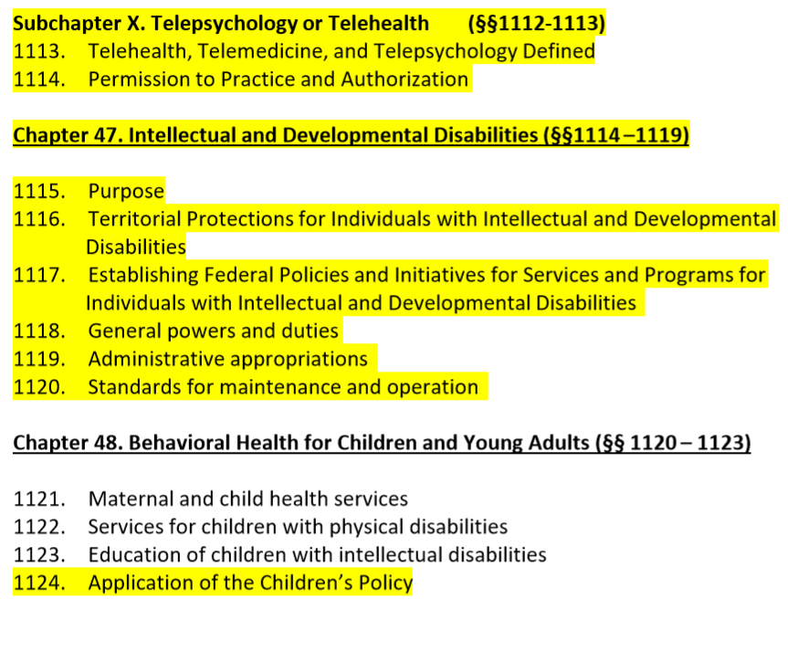
Key Provisions
Telepsychology
Protections for individuals with intellectual and developmental disabilities
Children and Adult Behavioral Health polices and enforcements

